Slide 1
An Introduction to the Personal Property Disposal Process

Slide 2
GSA Property Management Mission Statement
To provide the services, expertise, and systems that will ensure the timely, effective, and efficient disposition of the Federal government’s excess and surplus personal property, yielding the greatest return on investment to the taxpayer

Slide 3
Do you have any property disposal questions?
Ever wonder what to do with personal property once you no longer need it?
Can an agency sell surplus property themselves?
Am I obligated to acquire excess property if it is available rather than buy a similar item new?
Are there special procedures to follow when our office must relocate with short notice?
Notes:
The federal government purchases more supplies and materials than any other entity in the world?
The federal government faces the challenge of disposing excess and surplus property on a continuous basis.
The federal management regulation, sub chapter b Personal Property 41 Code of Federal Regulations [CFR 102-36], requires that executive agencies to the maximum extent practicable fill requirements for personal property by using existing agency property or by obtaining excess process from other federal agencies in lieu of new procurements.
As a result, federal property managers saves millions of taxpayer dollars each year by acquiring and using excess personal property.

Slide 4
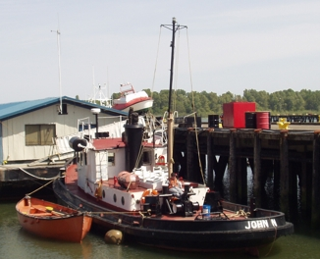
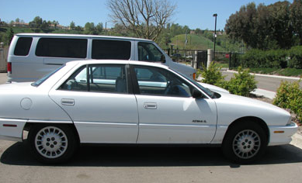
What does the Property Division do?
We assist agencies in acquiring and disposing of excess personal property
Notes:
The program is one of the largest property-management programs in federal government.
Our program includes
-Internal screening and reassignment of excess property to other activities within a federal agency
Utilization of excess personal property meaning transferring from one federal agency to another federal agency
- Donation of excess personal property that is no longer required by all federal agencies can then be designated as surplus and donated to the State
- Sale of Surplus property, where proceeds can be shared with the owning agency and GSA based on type of sale or proceeds returned to the U.S. Treasury
Area Property Officers are available for assistance.
As an APO we assist agencies with the personal property disposal cycle.

Slide 5
Terms and Terminology
A rudimentary understanding of key property terms and phrases will help you develop a clearer perspective of the disposal process.
Area Property Officer (APO)- Field representatives with assigned geographic areas within the United States and its territories. APOs assist federal agencies, nonfederal recipients, and SASPs on property disposal.
National Utilization Officer (NUO)- Designated “lead” agency property management official whose duties consist of broad responsibilities related to the utilization of personal property.
Federal Agency – Any executive agency or any establishment in the legislative or judicial branch of the Government.
Notes:
An APO is your first line of contact when disposing of personal property
Each federal agency has a NUO which can assist in providing guidance regarding an agency’s specific property disposal procedures. NUO’s also grant agency personnel access to GSAXcess

Slide 6
Terms and Terminology
Executive Agency – Any executive department or independent establishment in the executive branch of the Government.
Public Agency – Any state, political subdivision thereof, including any unit of local government. Also includes any Indian tribe group or community located on a state reservation.
Holding Agency – The Federal agency having accountability for, and generally possession of, the property involved
State Agency for Surplus Property (SASP)- The agency designated under state law to receive federal surplus personal property for distribution to eligible donees within the state as provided for in 40 USC 549.
Notes:
The SASP is a key partner in the property disposal process as they are involved in the Federal donation of surplus property to eligible public agencies and eligible non-profit organizations

Slide 7
Terms and Terminology
Donee- Any of the following entities that receive federal surplus personal property through an SASP:
- A public agency which uses surplus property to carry out or promote one or more public purposes
- An eligible nonprofit, tax-exempt organization
- A Service Educational Activity (SEA)
Service Educational Activity – Any educational activity designated by the Secretary of Defense as being of special interest to the armed forces (Maritime Academies, Military, Naval, Air Force, Army or Coast Guard Preparatory Schools, Boy Scouts, Little League Baseball)
Notes:
Donees must meet certain federal requirements in order to receive federal surplus property. The appropriate SASP will work with donee applicants to ensure they meet all eligibility requirements as well as meet the terms and conditions of donation
Service Educational Activity applicants are granted eligibility to participate in the Federal Donation Program by the DoD and can only accept DoD property.

Slide 8
Terms and Terminology
Personal Property – Any property except real property.
Excess Property- Any personal property under the control of any federal agency that is no longer required for that agency’s needs, as determined by the agency head or designee.
Surplus Property- Excess personal property no longer required by federal agencies and is available to the State and Non Profit Organizations.
Notes:
Reiterate that a transfer occurs when a federal agency requests and accepts excess personal property and a donation occurs when a SASP requests and accepts surplus property

Slide 9
Terms and Terminology
Transfer- The reassignment of property internally between offices within a federal agency or transfer externally between federal agencies.
Donation- Transfers of property from the federal agencies to be donated to state and local government agencies and eligible nonprofit organizations.

Slide 10
Terms and Terminology
Abandonment and Destruction - Ultimate disposal of property that has no commercial value or the cost of continued care and handling exceeds its estimated proceeds from sale.
Allocation - To assign property to eligible entities for transfer or donation purposes.
Surplus Release Date – The date when Federal screening has been completed and the “excess” property becomes “surplus”
Notes:
Screen – the act of viewing excess and surplus property- both on-line and in person.

Slide 11
Terms and Terminology
Report – To Notify/The Notification of GSA of available excess property
Screening- Federal Agencies and the SASP are able to view/search for the property
Select (“Freeze”)- Federal Agencies or the SASP makes a request for the property

Slide 12
Terms and Terminology
Exchange/Sale Property - Property not excess to the needs of the holding agency but eligible for replacement (w/some restrictions). The exchange (trade-in) allowance or sale proceeds are used to pay for replacement with a similar item.
Reimbursable Property – Property that because of its funding source or exchange sale designation allows an agency to be compensated from proceeds
Computers For Learning (CFL) – GSA program to implement Executive Order 12999, which directs agencies, to the extent permitted by law, to transfer computer and related peripheral equipment excess to their needs directly to schools and some educational nonprofit organizations. (www.computersforlearning.gov)
Notes:
Exchange sale property is governed by FMR 102-39 and is outside of the property disposal process.
Under the CFL program, the holding agency will make allocation determinations and as such are responsible for ensuring that a school or educational non-profit organization is eligible to receive federal computer related property.

Slide 13
Terms and Terminology
GSA Auctions – GSA’s internet sales site. It offers on-line auctions of surplus and exchange/sale property. (www.gsaauctions.gov)
GSAXcess – GSA’s automated excess personal property system. It allows for automated reporting of excess property, searching and selecting property, and processing transfers. (www.gsaxcess.gov)
Mysales - GSA’s website for agencies’ personal property inventory reported to GSA for sale. The website allows federal agencies to review and modify the surplus and exchange/sale property they reported to GSA for sale. (www.mysales.fss.gsa.gov)
Notes:
www.GSAXcess.gov – online screening website for excess and surplus personal property
www.GSAAuctions.gov – online screening website for selling personal property to the general public

Slide 14
Condition Code Terminology
Disposal Condition Code | Definition
N | New. Property which is in new condition or unused condition and can be used immediately without modifications or repairs.
U | Usable. Property which shows some wear, but can be used without significant repair.
R | Repairable. Property which is unusable in its current condition but can be economically repaired.
X | Salvage. Property which has value in excess of its basic material content, but repair or rehab. Is impractical and/or uneconomical.
S | Scrap. Property which has no value except for its basic material content.
Notes:
Self-Explanatory chart – go over the condition codes

Slide 15
FEDERAL DISPOSAL PROCESS
EXCESS
SURPLUS
SCREENING
AAMS/EADS/IADS
SCREENING/
FEDERAL TRANSFER
21 DAYS
DONATION
NOTIFICATION
5 DAYS
AGENCY
SCREENING
CFL
SCREENING
SALES
DONATION
REMOVAL
Internal
Agencies/Bureaus
of your Dept
USDA - 15
VA - 10
GSA - 5
DOE - 12
DOC – 15
DOI - 15
Schools Screen Computer Equipment for 7 Days
Federal Agencies
Cost Reimbursable Contractors
Grantees
Only if donation request
Sales 10 - 30 days
Public Airports
State Agencies for Surplus Property
Nonprofit Educational & Public Health Activities
Service Educational Activities
(14 days if CFL equipment)
Notes:
What is the difference between “excess” and “surplus” property?
This is a graphic portrayal of the disposition process since the implementation of GSA XcessXpress. The chart shows the distinction of excess and surplus property as well as highlighting the overall screening period and the systems that GSA offers to support these functions.
Internal agency screening is the first step and we offer AAMS to support agencies in this effort.
Second, is the simultaneous screening for Federal and donation customers and federal removal. Listed are the major categories of eligible activities.
Next, the 5 day notification period allows GSA’s allocating regions to make proper allocation of property to donation customers. The 5 days only come into play if a State Agency for Surplus Property or donation customer makes a request. After that, property is available for public sale, by GSA or the owning agency.

Slide 16
How long does the disposal process take?
Utilization & Disposal Screening
Internal screening varies by agency
21 calendar days GSA Federal/Donation screening
First 7 days of 21 day period - Computers For Learning (CFL)
14 calendar days – Office Furniture (FSC 7110)
3 calendar days – Exchange/Sale Property
Removal – 15 days normal, 21 days for DOD excess
Notes:
Average total cycle time is does not include internal screening time frames.
USDA - 15
VA - 10
GSA - 5
DOE - 12
DOC – 15
DOI - 15

Slide 17
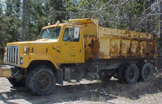
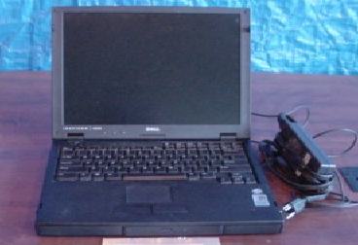
What is personal property?
Anything that is NOT:
Land
Permanent Buildings
Battleships
Cruisers
Submarines
Aircraft Carriers
Destroyers

Slide 18
How long does the disposal process take?
Sales Time Frame
30 calendar days average sales cycle time
(includes verifying availability, posting, collection & removal)
Notes:
5 days to roll into Sales System after the Surplus release date
5-10 Days Business Days to Lot items and modify item descriptions where necessary
Property screens 7 Days on GSAAuctions
After sale winning bidder has 10 business days to remove property.

Slide 19
How does FAS Property assist agencies in disposal?
Property is first offered to other Federal agencies
This helps to avoid Federal agencies from buying something that another agency already has but does not need.
It also helps in disposing of property that is not needed but would otherwise have to be stored if a new home is not found.

Slide 20
Next, the property is offered to the States
If no Federal requests, GSA can donate the property to the States for free
The property is only given to one agency in each State – the State Agency for Surplus Property (SASP)
SASPs coordinate the federal surplus property program
Each State and Territory has a SASP
www.nasasp.org
Notes:
This helps save taxpayer money within the States and U.S. Territories
SASPs are state-run organizations that coordinate the federal program for the donation of federal surplus property

Slide 21
State Agency for Surplus Property’s Role
Distributes Federal surplus personal property to eligible donees for a service fee
The SASP determines who qualifies for Federal property based on Federal laws, rules and regulations
Does compliance checks to ensure the property is used for the purpose for which it was given

Slide 22
Who qualifies for property under the SASP?
Veterans Service Organizations
Public Agencies - Local, County, Regional, or State
Supported by tax dollars
Created by law
Certain Non-Profit, Tax Exempt Organizations
Educational, Health, or Elderly
Homeless or Impoverished

Slide 23
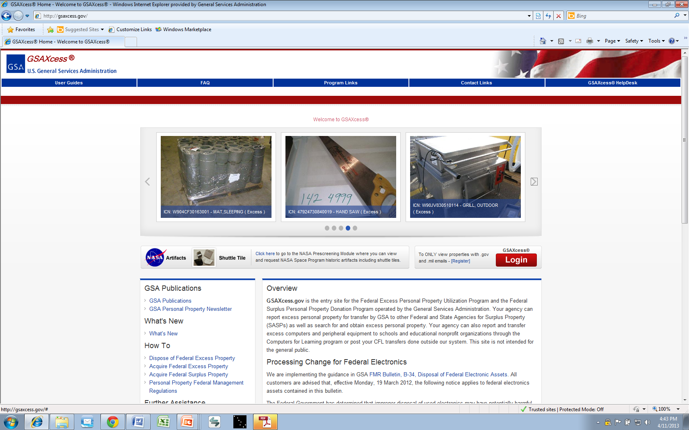
How do Federal agencies and the States find out what property is available?
GSA’s internet database of all excess property
www.GSAXcess.gov

Slide 24
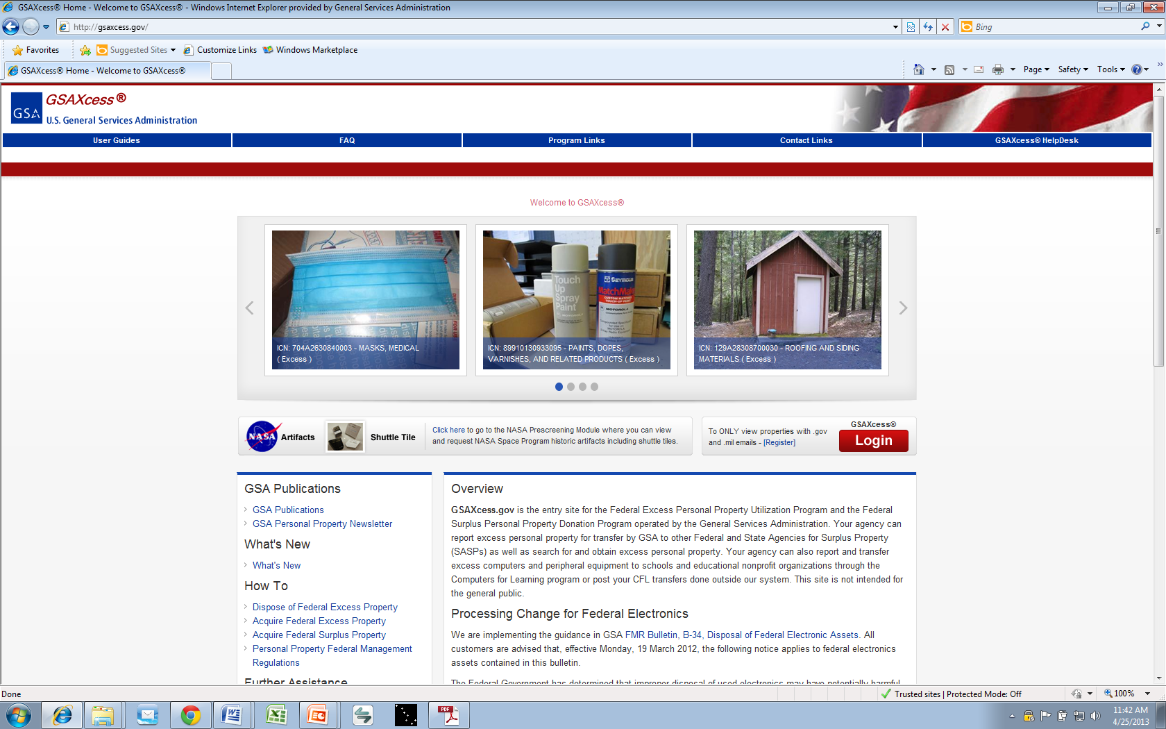

Slide 25
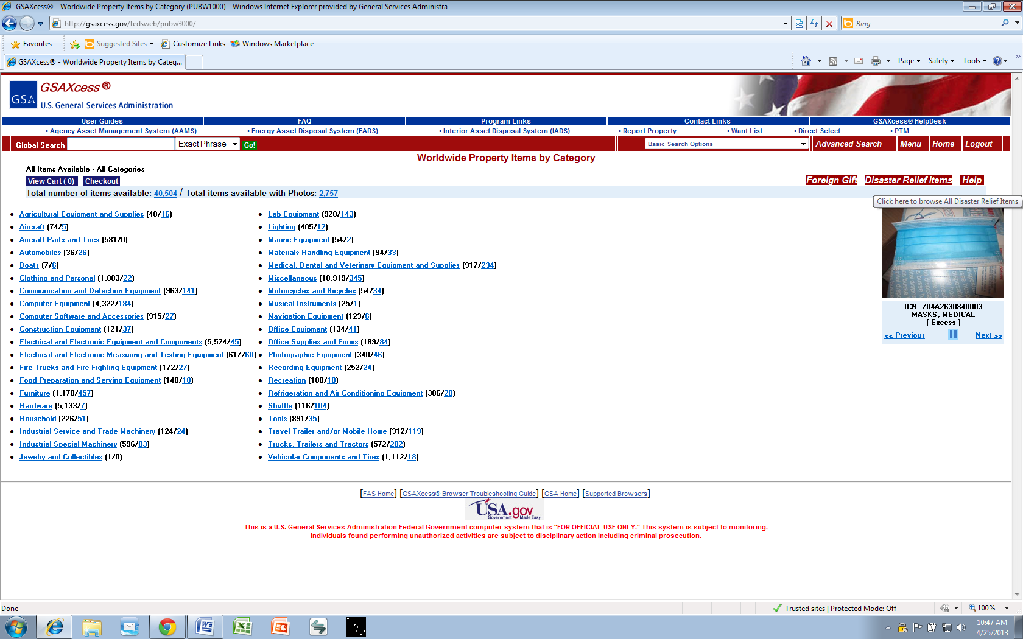
Notes:
Approximately 40 Worldwide Property Categories

Slide 26
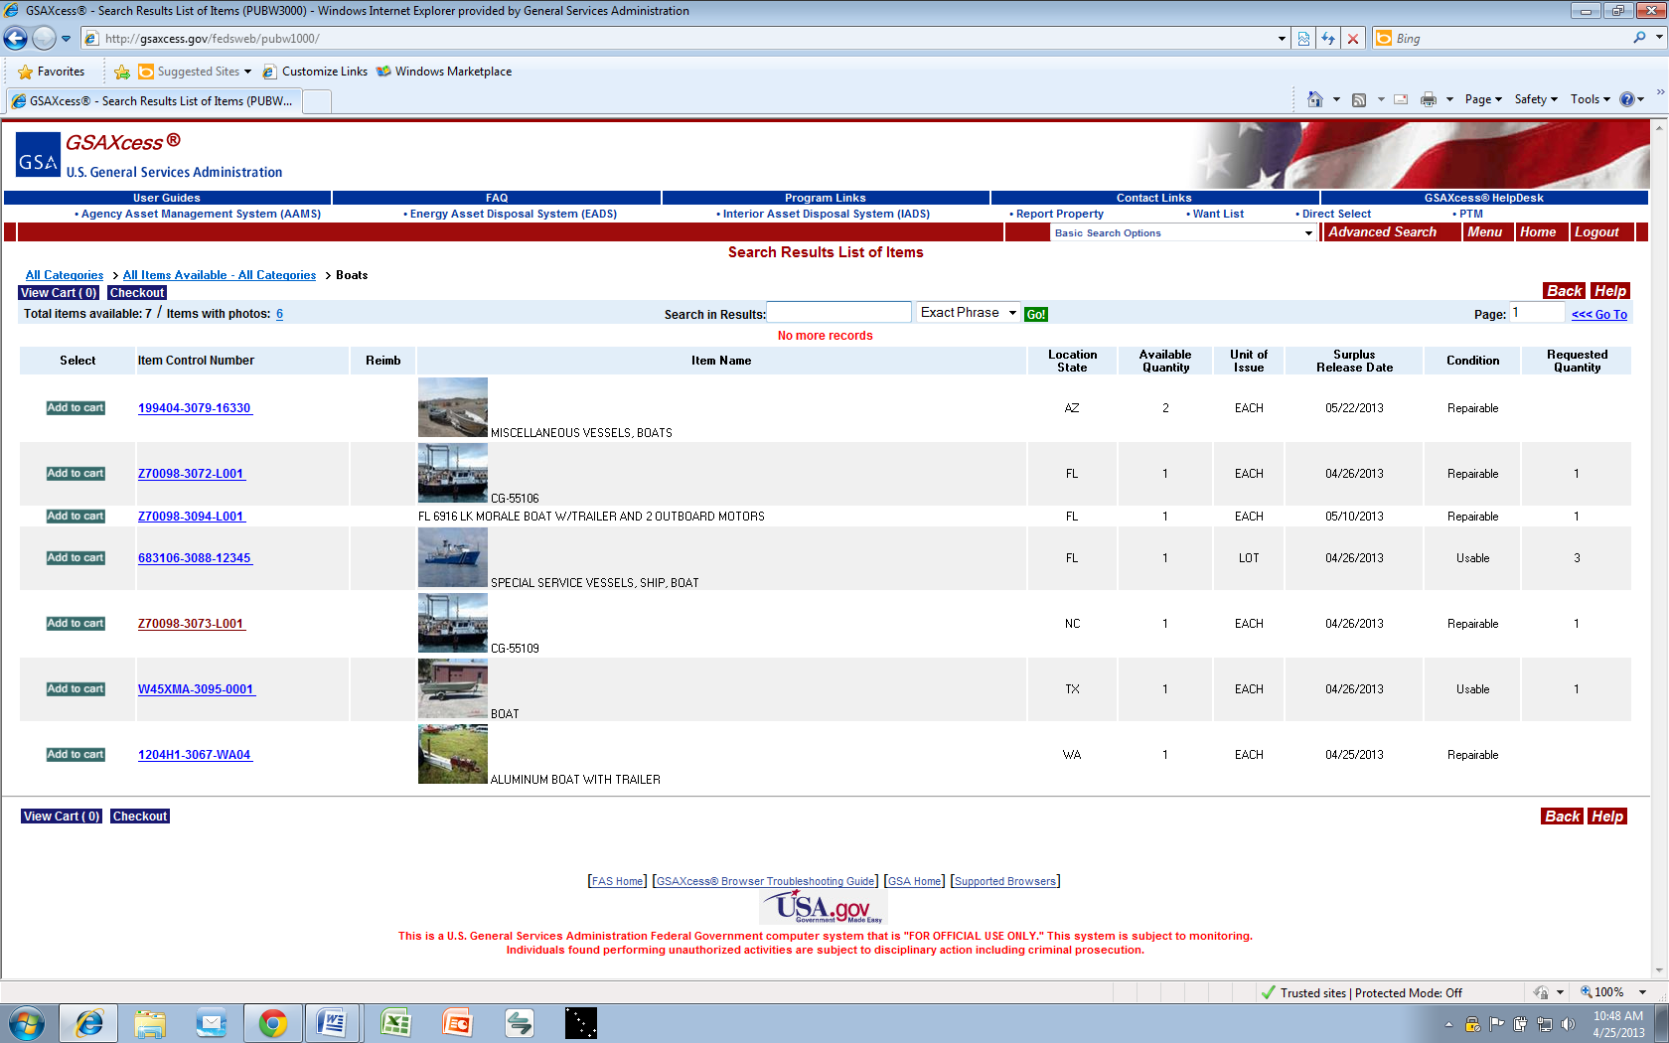

Slide 27
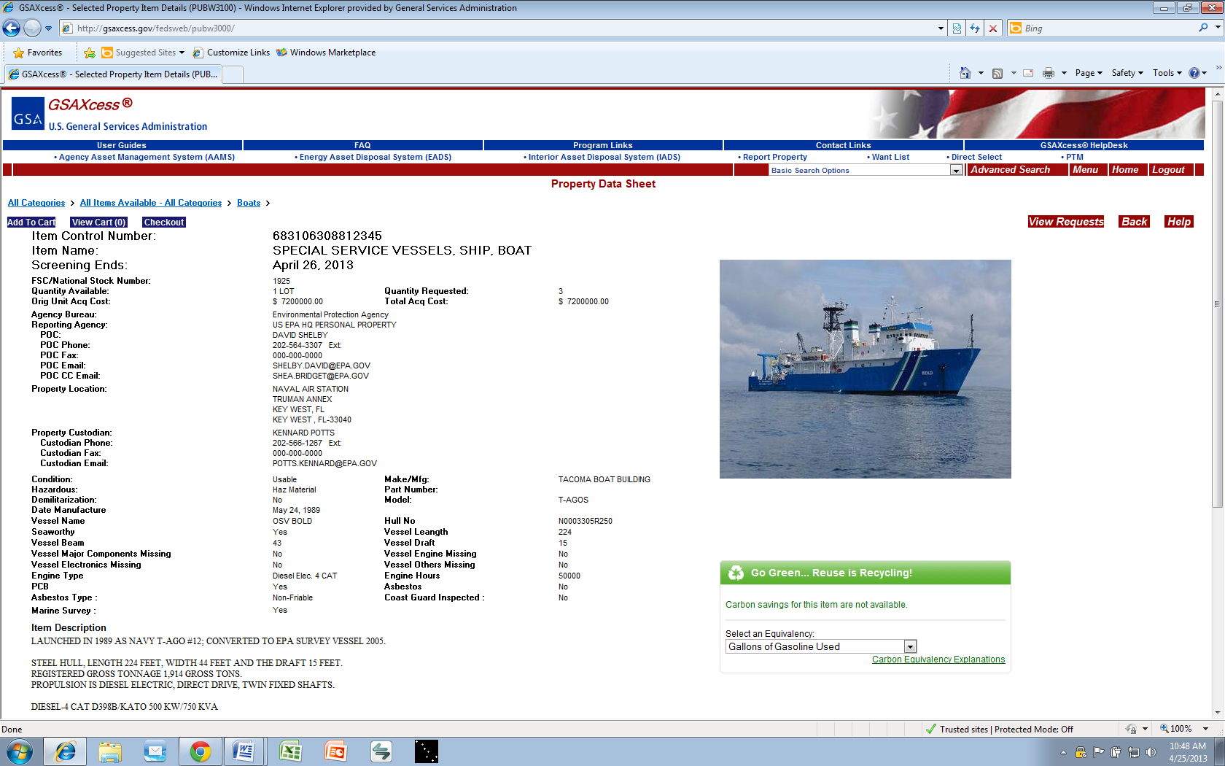

Slide 28
What if no Federal Agency or State wants the property?
FAS, Property Division will then offer the property for auction to the general public on GSA’s internet auction site:
GSAAuctions.gov

Slide 29
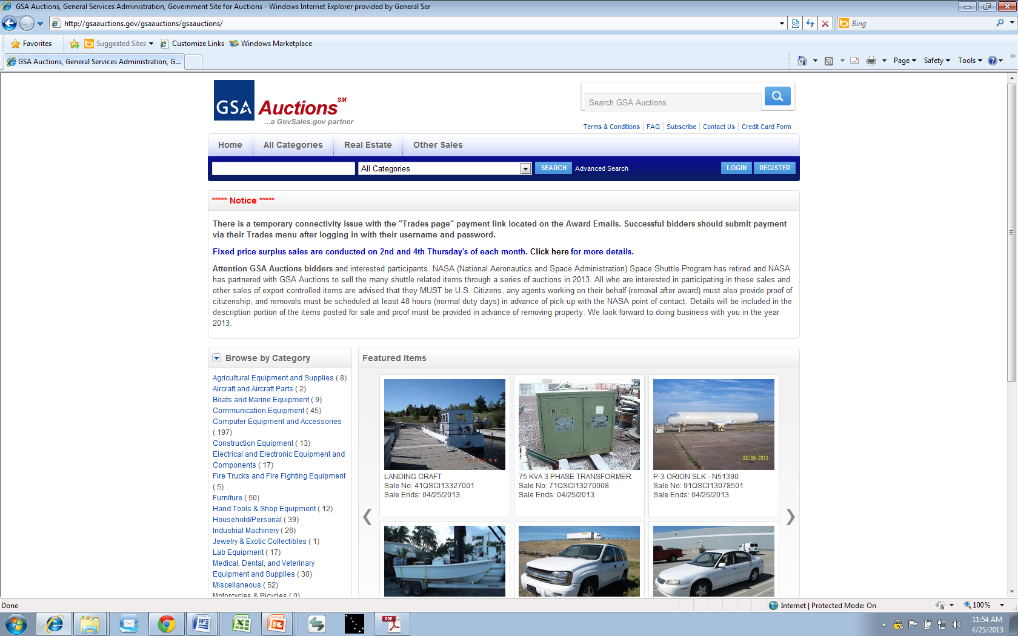

Slide 30
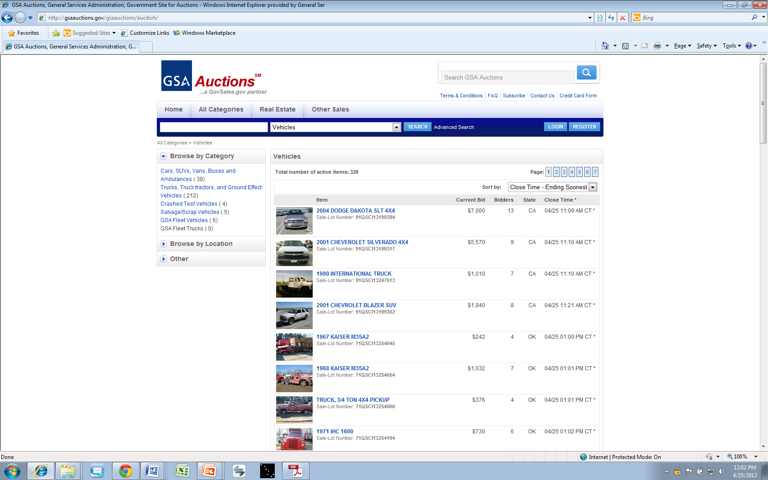

Slide 31
Who can bid on GSAAuctions.gov?
The general public
Private individuals
Businesses and companies
GSA employees are not allowed to bid on anything being sold on GSAAuctions.gov

